Slide 1
ADVANCED WEB PROGRAMMING(18CS551)

Slide 2
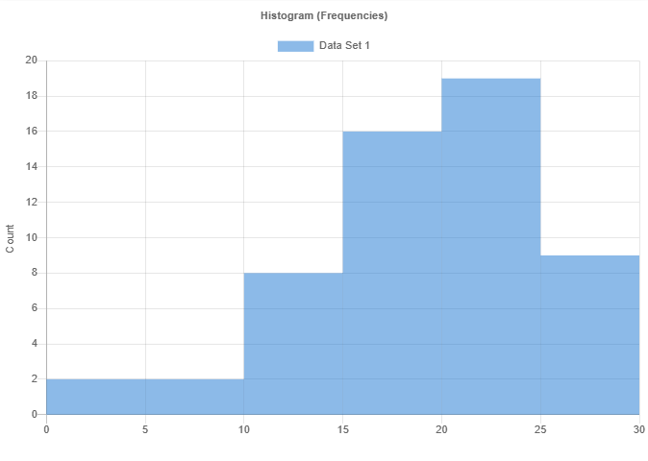
Histogram of IA Marks

Slide 3
IA 1 Data Analysis
Metric | Result
Mean | 19.24107
Median | 19.75
Std Dev | 5.8976
Skewness | -0.74428
Kurtosis | 0.09222
Min | 3.5
Max | 28.5
Range | 25.0
# of Scores | 56
# of Unique Scores | 31
Bin Boundary (Min) | 0
Bin Boundary (Max) | 30
# of Bins | 6
Bin Size | 5

Slide 4
IA 1 Data Analysis
Metric | Result | Bin | Count
 |  | 0 - 5 | 2
 |  | 5 - 10 | 2
 |  | 10 - 15 | 8
 |  | 15 - 20 | 16
 |  | 20 - 25 | 19
 |  | 25 - 30 | 9

Slide 5
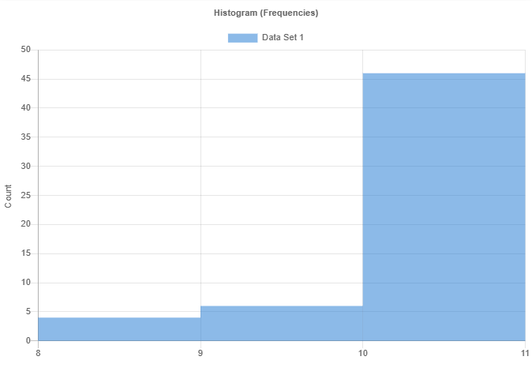
Histogram of Assignment 1 Marks

Slide 6
Assignment 1 Data Analysis
Metric | Result | Bin | Count
Mean | 9.75
Median | 10.0
Std Dev | 0.57997
Skewness | -2.2472
Kurtosis | 3.92556
Min | 8.0
Max | 10.0
Range | 2.0
# of Scores | 56
# of Unique Scores | 3
Bin Boundary (Min) | 8
Bin Boundary (Max) | 11
# of Bins | 3
Bin Size | 1

Slide 7
Assignment 1 Data Analysis
Metric | Result | Bin | Count
 |  | 8 - 9 | 4
 |  | 9 - 10 | 6
 |  | 10 - 11 | 46

Slide 8
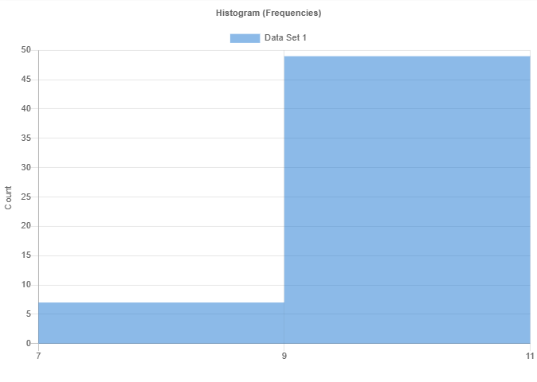
Histogram for Assignment 2 Marks

Slide 9
Assignment 2 Data Analysis
Metric | Result | Bin | Count
Mean | 9.33929
Median | 9.5
Std Dev | 0.79262
Skewness | -1.14949
Kurtosis | 1.02111
Min | 7.0
Max | 10.0
Range | 3.0
# of Scores | 56
# of Unique Scores | 4
Bin Boundary (Min) | 7
Bin Boundary (Max) | 11
# of Bins | 2
Bin Size | 2

Slide 10
Assignment 2 Data Analysis
Metric | Result | Bin | Count
 |  | 7 - 9 | 7
 |  | 9 - 11 | 49

Slide 11
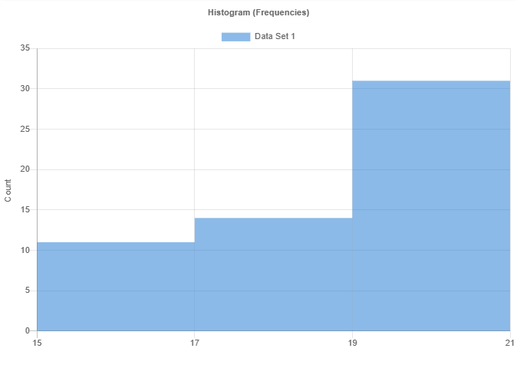
Histogram for Course Activity Marks

Slide 12
Course Activity Data Analysis
Metric | Result | Bin | Count
Mean | 18.39286
Median | 19.0
Std Dev | 1.77537
Skewness | -0.72683
Kurtosis | -0.84579
Min | 15.0
Max | 20.0
Range | 5.0
# of Scores | 56
# of Unique Scores | 6
Bin Boundary (Min) | 15
Bin Boundary (Max) | 21
# of Bins | 3
Bin Size | 2

Slide 13
Course Activity Data Analysis
Metric | Result | Bin | Count
 |  | 15 - 17 | 11
 |  | 17 - 19 | 14
 |  | 19 - 21 | 31

Slide 14
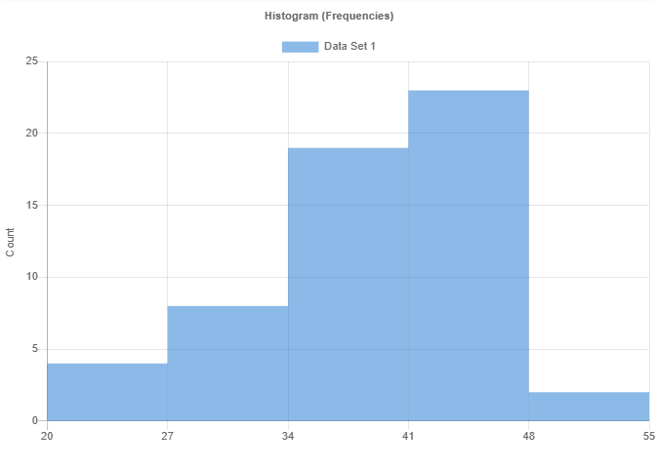
Histogram for Total CIE Marks

Slide 15
Total CIE Marks Data Analysis
Metric | Result | Bin | Count
Mean | 38.23214
Median | 39.0
Std Dev | 6.69054
Skewness | -0.75576
Kurtosis | 0.32483
Min | 20.0
Max | 49.0
Range | 29.0
# of Scores | 56
# of Unique Scores | 23
Bin Boundary (Min) | 20
Bin Boundary (Max) | 55
# of Bins | 5
Bin Size | 7

Slide 16
Total CIE Marks Data Analysis
Metric | Result | Bin | Count
 |  | 20 - 27 | 4
 |  | 27 - 34 | 8
 |  | 34 - 41 | 19
 |  | 41 - 48 | 23
 |  | 48 - 55 | 2

